Slide 1


NAMED ENTITY RECOGNITION(NER)
Master of Science (Data Science)
Department of Computer Science
Submitted to:
Department of Computer Science,
Banasthali Vidyapith,
RajasthaN
PRESENTATION BY:
Devanshi Suri (2242852)
NIMISHA MALVIYA (2242855)
TANUJA JANGID (2242863)

Slide 2
Agenda
1
2
3
4
Specific Requirements
introduction
General Description
Class Diagram
5
6
7
8
ACTIVITY Diagram
FLOWCHARTS
Sequence Diagram
Screen Images
9
10
11
Types of Testing
conclusion
Reference

Slide 3

INTRODUCTION
Named Entity Recognition is an NLP technique which involves the identification and classification of named entities within a text.
The primary goal of our NER Model is to locate and categorize these named entities from Hindi text into 5 categories i.e. Location, Organization, Person's Name, Date, and Time.
जवाहरलाल नेहरू का जन्म 14 नवंबर 1889 की सुबह 11:09 जवाहरलाल नेहरू मार्ग पर स्थित जवाहरलाल नेहरू अस्पताल में हुआ था।

Slide 4
Purpose
Limited efforts in developing Named Entity Recognition (NER) systems for Indian languages
To improve the presence of Hindi on the internet, an accurate Hindi NER system is required
For Indian languages like Hindi, there haven't been many NER initiatives.
An English NER system cannot be used directly for the Hindi language
There is a lack of an extensive labeled dataset.
Hindi, a widely spoken language, lacks internet representation, and an accurate NER system can address this gap.
Accurate NER enables the development of advanced Hindi NLP applications, chatbots, and automation.
Accurate NER supports effective governance and public sentiment monitoring in Hindi-speaking regions.

Slide 5
Scope
QUESTION ANSWER GENERATING SYSTEM
INFORMATION RETRIEVAL
MACHINE TRANSLATION
TRANSLITERATION
INFORMATION EXTRACTION
SPELL CHECKER

Slide 6
GENERAL DESCRIPTION

Slide 7
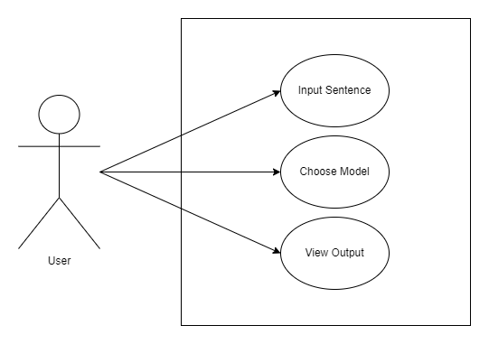
Product function
Fig :- Use Case Diagram

Slide 8
Hardware and software interface
Hardware interface
Software interface
Developer | User
Processor: 10th Gen Intel® CoreTM i5 2.50 GHz | Processor: 10th Gen Intel® CoreTM i3 2.50 GHz
RAM: 8 GB | RAM: 4 GB and above
HDD: 256 GB | HDD 4 GB
Developer | User
OS: Windows 10 | OS: Windows 10 and above
Applications: Jupyter Notebook v7.0.0a11, Pycharm, Google Chrome version 109 and above, Mozilla Firefox version 79 and above | Applications: Google Chrome version 109 and above, Mozilla Firefox version 79 and above

Slide 9
Communication Interface
Website will be locally hosted on system browser
User Characteristics
The user should be computer, Hindi and English language literate.
Constraints
A working browser must be available for use. I​nput must be given in Hindi.
Technologies Used
We will use Python to develop the rule-based model and to fine tune transformer model BERT.
Streamlit library is used to develop the user interface.

Slide 10
SPECIFIC REQUIREMENTS

Slide 11
FUNCTIONAL requirements
Topic | Description
Use case name | Enter input sentence
Use case Overview | Allows the user to input Hindi sentence
Actor(s) | User
Pre-conditions | Should be Hindi language literate.
Post-conditions | A model is selected and named entity recognition is performed.
Exception Flow | If the input is not in Hindi, user will be asked to re-enter the text

Slide 12
FUNCTIONAL REQUIREMENTS
Topic | Description
Use case name | Choose Model
Use case Overview | Choose between two models viz. Rule-based and BERT model
Actor(s) | User
Pre-conditions | Input Hindi text only
Post-conditions | A model is selected and NER is performed.
Topic | Description
Use case name | View Output
Use case Overview | User view named entities extracted from Hindi text
Actor(s) | User
Pre-conditions | A model must be selected
Post-conditions | Classified named entities will appear

Slide 13
Non FUNCTIONAL REQUIREMENTS
Maintainability:
Portability
It is easy to maintain the system as it does not require any special maintenance.
It is easily portable as it is implied on a regular computer.
Robustness
Reliability
The application is developed in such a way that any future enhancement can be easily implementable. It requires minimal maintenance
The system is reliable for any number of corpus and training dataset.

Slide 14
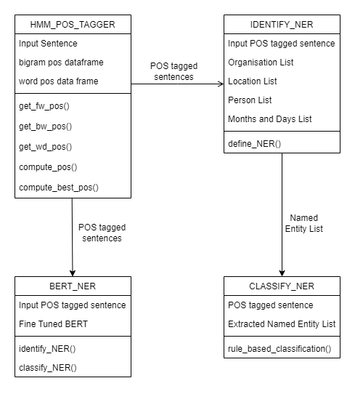
Class Diagram

Slide 15
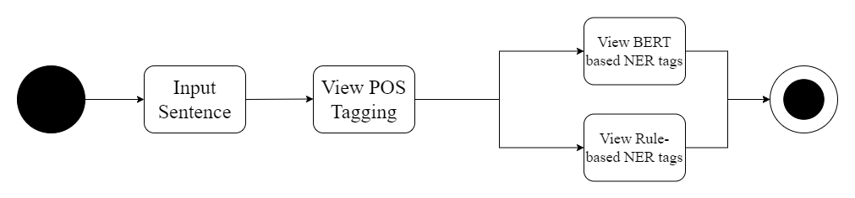
Activity Diagram

Slide 16
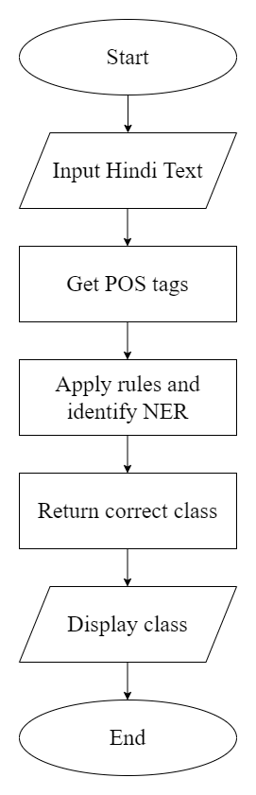
Flowchart- Rule based model

Slide 17
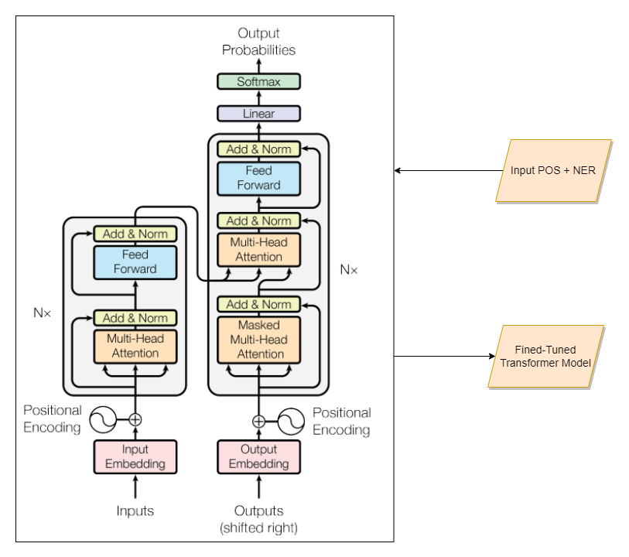
Flowchart- Training, BERt-BASED MODEL

Slide 18
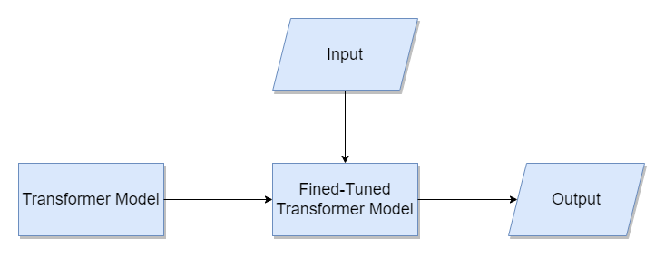
Flowchart-Testing, BERt-BASED MODEL

Slide 19
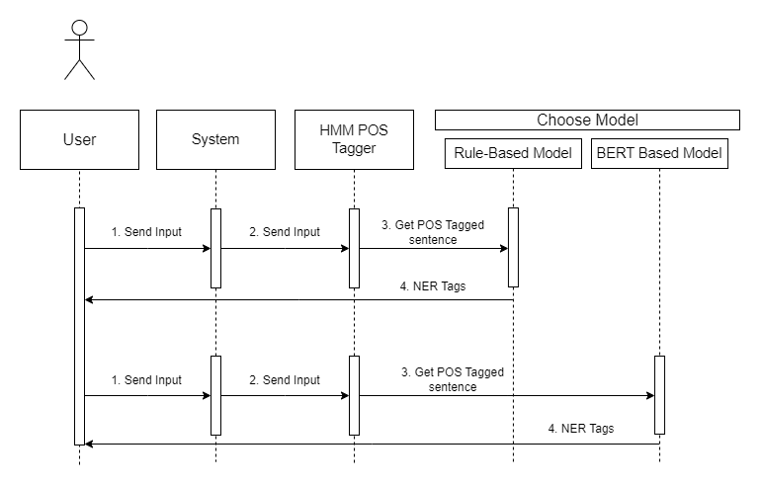
sequence Diagram
19

Slide 20
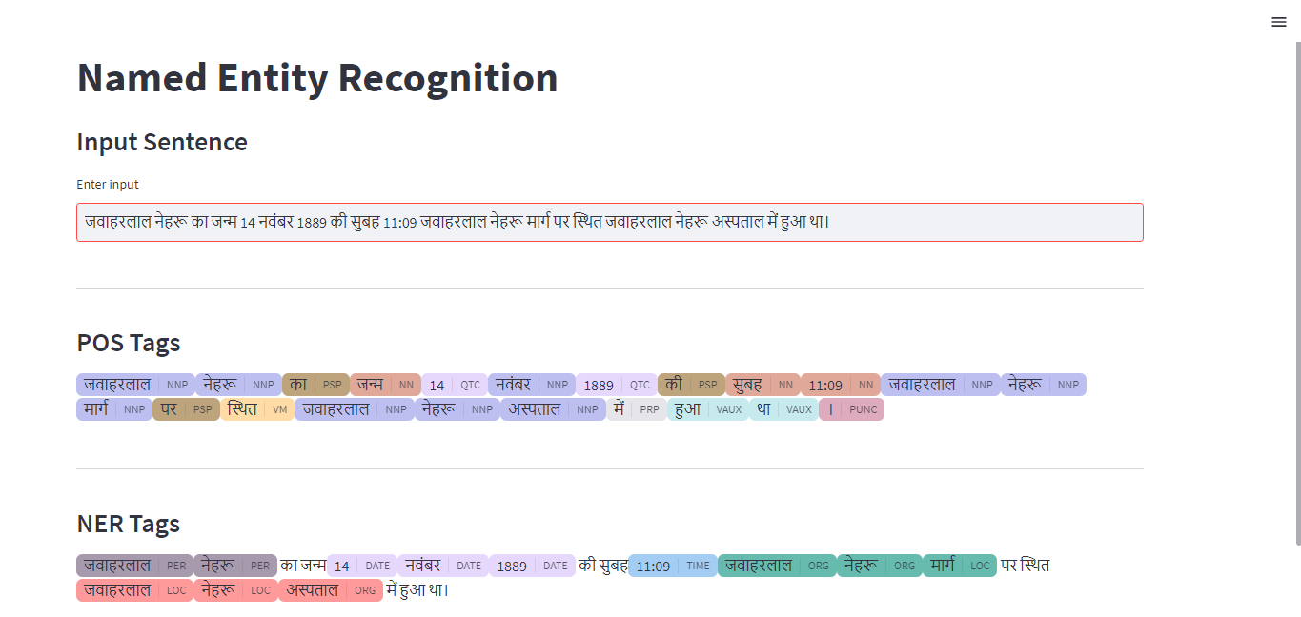
Screen Image

Slide 21
Types of Testing
Stress Testing
Integration Testing
Unit Testing
tests software beyond normal operation limits
emphasizes robustness, availability and error handling under heavy load.
performs to prevent system crashes during crunch situations.
focuses on testing the interface between software units or modules
identifies faults between the integrated units
conducted after unit testing.
aims to detect problems when different components are combined
validates individual units or components of a software system
ensure each unit work as intended and meet the requirement
conducted early in the development process
helps identify and fix issues early

Slide 22
Conclusion
Overall, our project aims to recognize name entities form Hindi text, which will contribute to information retrieval and improving content categorization for Hindi language.

Slide 23
REFERENCES
Choure, A. A., Adhao, R. B., & Pachghare, V. K. (2022). NER in Hindi Language Using Transformer Model:XLM-Roberta. 2022 IEEE International Conference on Blockchain and Distributed Systems Security (ICBDS), (pp. 1-5). Pune, India. doi:10.1109/ICBDS53701.2022.9935841
Murthy, R., Bhattacharjee, P., Sharnagat, R., Khatri, J., Kanojia, D., & Bhattacharyya, P. (n.d.). HiNER: A Large Hindi Named Entity Recognition Dataset. arXiv preprint arXiv:2204.13743.
pp_pankaj. (2023, February 6). Unit Testing | Software Testing. Retrieved from GeeksforGeeks: https://www.geeksforgeeks.org/unit-testing-software-testing/#article-meta-div
pp_pankaj. (2023, May 24). What is Stress Testing in Software Testing? (GeeksforGeeks) Retrieved September 16, 2023, from https://www.geeksforgeeks.org/stress-testing-software-testing/
Software Engineering | Integration Testing. (2023, April 6). Retrieved from GeeksforGeeks: https://www.geeksforgeeks.org/software-engineering-integration-testing/

Slide 24
Thank You

